Slide 1
Wind Power
Fundamentals
Yrd.Doç.Dr.Fazıl Nihat BODUR

Slide 2
Overview
Reasons for renewables (do’s and don’ts)
Where in the design process to consider renewables
What to look at (or where to start)
Estimating the available resource (solar, wind, biomass)
Technologies (and some things to watch out for)

Slide 3
Energy is a major input for overall socio-economic development of any society
The prices of the fossil fuels steeply increasing
So renewables are expected to play a key role
Wind energy is the fastest growing renewable
Wind turbines are up to the task of producing serious amounts of electricity

Slide 4
Why bother with renewables?
They can be:
•Expensive
•Intermittent
•Unreliable
•Unsightly
•An incomplete solution
But can also:
•Reduce energy bills
•Raise energy awareness
•Reduce carbon footprint
•Improve corporate identity
•Provide energy security

Slide 5
Origin of Wind
Wind – Atmospheric air in motion
Energy source
Solar radiation differentially absorbed by earth surface
converted through convective processes due to temperature
differences air motion
Spatial Scales
Planetary scale: global circulation
Synoptic scale: weather systems
Meso scale: local topographic or thermally induced circulations
Micro scale: urban topography

Slide 6
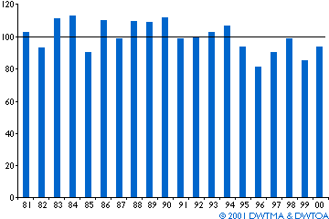
Wind Varies Annually
Average annual wind speeds may vary as much as 25% from year to year
Notes:
When siting a wind farm, wind must be studied in many ways to determine if a site will be a strong producer of electricity.

Slide 7
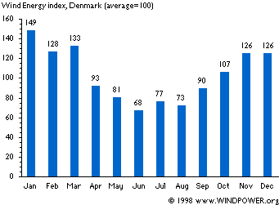
Wind Varies Seasonally

Slide 8
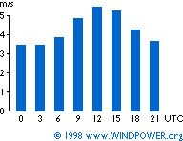
Wind Varies Daily
Wind varies daily not only because of weather but because of convective heating
Winds typically strongest in mid-late afternoon
Convective heating is less of an influence in winter, when storms dominate wind patterns

Slide 9
Wind turbine Designs
Horizontal axis wind turbines (HAWT) are the most popular - compared to vertical axis wind turbines (VAWT).
–Advantages of VAWT: (a) automatically faces the wind, (b) the heavy machinery can be located on the ground, (c) lightweight.
–Disadvantages of VAWT: (a) the blades are close to the ground (low speed, turbulent wind), (b) hard to spill the wind.

Slide 10
Upwind versus Downwind HAWT
Downwind: the wind controls the yaw (left– right motion), i.e., it orients itself with respect wind direction. But the shadowing effects of the tower causes the blade to flex, thus resulting in fatigue, noise and reduces power output.
•Upwind: requires a complex yaw control systems to keep the blades facing into the wind, but operates more smoothly and deliver more power. Most modern wind turbines are of the upwind type.

Slide 11
Optimal Number of blades
If more than 3 blades, the turbulence caused by one blade affects the efficiency of the blade that follows.
• If less than 3 blades, power and torque pulsations will appear at the generator terminals
• Three-bladed turbines show smoother and quieter operation, with minimum aerodynamic interference.

Slide 12
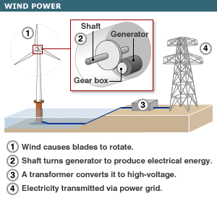
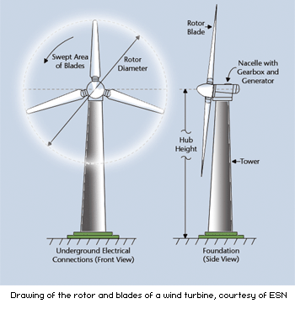
Getting Wind Power to the Grid

Slide 13
Components of a wind turbine

Slide 15
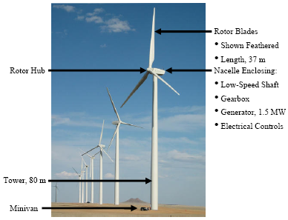
What is a wind plant? Tower & Blades

Slide 16
Wind Turbine Subsystems
Foundation
– Tower
– Nacelle
– Hub & Rotor
– Drivetrain
– Gearbox
– Generator
– Electronics & Controls
– Yaw
– Pitch
– Braking
– Power Electronics
– Cooling
– Diagnostics

Slide 17
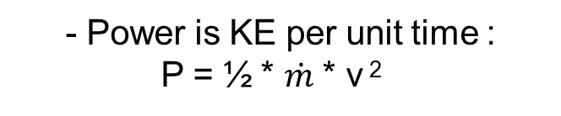

Fundamental Equation of Wind Power
Wind Power depends on:
• amount of air (volume)
• speed of air (velocity)
• mass of air (density)
flowing through the area of interest (flux)
Kinetic Energy definition:
  KE = ½ * m * v ²
•$\dot{ m}=\frac{dm}{dt}$
– Thus:
• P = ½ * ρ * A * v ³
- Power is KE per unit time :
P = ½ * $\dot{m}$ * v ²
Fluid mechanics gives mass flow rate
(density * volume flux):
  dm/dt = ρ* A * v
Power ~ cube of velocity
Power ~ air density
Power ~ rotor swept area A= πr ²

Slide 18




Wind – available power
Power from the wind
$$P_{w}=\frac{1}{2}\dot{m}v^{2}=\frac{1}{2}ρAv^{3}$$
Betz limit
$$η_{max}=\frac{16}{27}=0.593$$
Power Coefficient, $C_{p}$
- In practice comes out at around 0.45
Actual Power
$$P_{actual}=\frac{1}{2}C_{p}ρAv^{3}$$

Slide 19
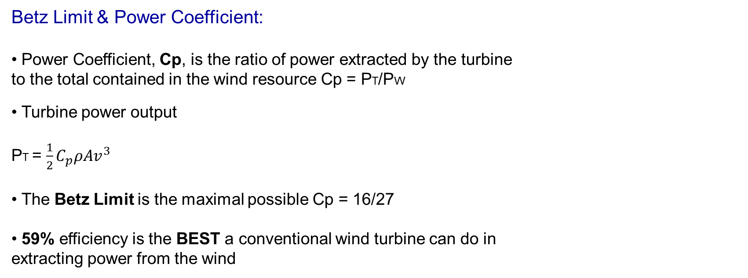
Efficiency in Extracting Wind Power
Betz Limit & Power Coefficient:
• Power Coefficient, Cp, is the ratio of power extracted by the turbine
to the total contained in the wind resource Cp = PT/PW
• Turbine power output
PT = $\frac{1}{2}C_{p}ρAv^{3}$
• The Betz Limit is the maximal possible Cp = 16/27
• 59% efficiency is the BEST a conventional wind turbine can do in
extracting power from the wind

Slide 20
Maximum rotor efficiency
Betz’s law (1919): The wind turbine blade efficiency is maximum when it slows the wind to one-third of its original velocity.
• → Maximum theoretical rotor efficiency = 59.3%
• Modern wind turbine blades can approach 80 percent of the above limit, i.e., 45% - 50% efficiency in converting the power in the wind into the power of a rotating generator shaft.
• For a given wind speed, rotor efficiency is a function of the rate at which the rotor turns. A common way to illustrate rotor efficiency is to present it as a function of the tip-speed-ratio:
where rpm is the rotor speed, D is the rotor diameter (m); and v is the wind speed (m/s) upwind of the turbine.

Slide 21
Wind – power output
Turbine performance may not match power curves
•Need to consider variability of the wind
•Wind speeds typically fit Weibull distribution
–Low wind speeds relatively common, higher speeds rarer

Slide 22
Capacitor Factor
Capacity factor of a wind power generator is defined as
for a site with an average wind speed of 7 m/s, cf is about 30%.
for a site with an average wind speed of 5 m/s, cf is about 12%.

Slide 23
Rotating machine-based interconnection
There are four types of utility-scale wind turbine generators (WTG) in the market, based on the generator topology and grid interface:
–Type 1: squirrel cage induction generator
–Type 2: wound-rotor induction generator with adjustable external rotor resistance
–Type 3: doubly-fed induction generator
–Type 4: induction generator with full converter interface

Slide 24
3-Phase induction machine construction
3 stator windings (uniformly distributed as in a synchronous generator)
• Two types of rotor:
–Squirrel cage
–Wound rotor (with slip rings)

Slide 25
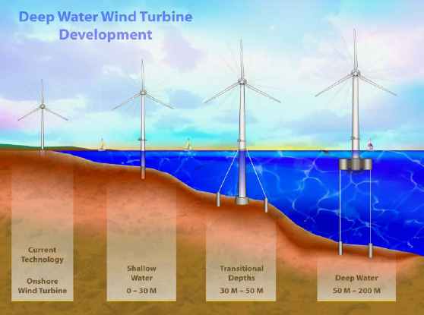
What is a wind plant?
Offshore
About 600 GW available 5-50 mile range
About 50 GW available in <30m water
Installed cost ~$3000/MW; uncertain because US cont. shelf deeper than N. Sea

Slide 26
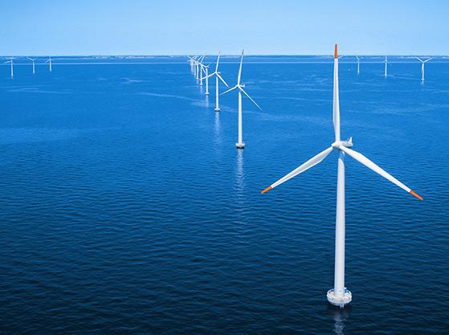
Off-Shore Wind Farms

